Slide 1
Understanding Core Data Structures and Constructs

Slide 2


Today's Learning Objectives
Introduction to Data Structures
Examining Stacks, Arrays, Hash Maps and Queues
Choosing the right data structure - case studies
Understanding Pseudocode

Slide 3



Large Amounts of Data
Banking
Search Engine
Raw Data
Results

Slide 4
Data Operations
Create
Read
Update
Sort
Insert
Search
Delete
Data must be organized into the right kind of structures for operations to work efficiently

Slide 5

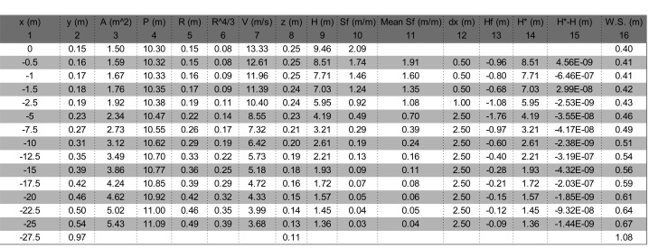
Data Organization in Real Life
We organize data in efficient structures in our daily lives

Slide 6
Data Structures

Slide 7
Computer Programming
Stacks
Queues
Hash Maps
Data Structures
Arrays
Trees
Graphs
Notes:
To Instructor: In this session we will only explore Stacks, Queues, Arrays and Hash Maps. Please do mention this in the session.

Slide 8
Stacks

Slide 9

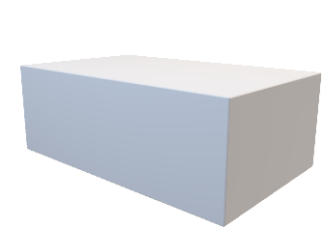
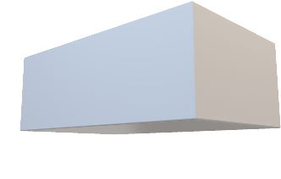
Data Structures | Stacks
A stack of boxes

Slide 10
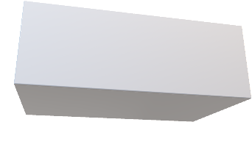
Data Structures | Stacks
New box goes on top of the stack
A stack of boxes

Slide 11
Data Structures | Stacks
The box on top of the stack is the first one to go
A stack of boxes

Slide 12
Data Structures | Stacks
Last-In-First-Out | LIFO
The box on top of the stack is the first one to go
A stack of boxes

Slide 13
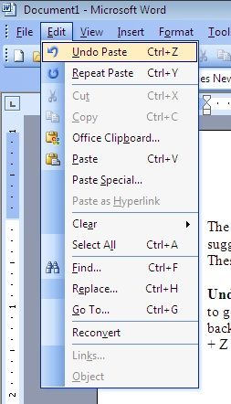
Data Structures | Stacks
The Undo feature is a great example of a stack. New actions are added to the top of the stack and when Undo is requested, the last added action is the first one to be undone

Slide 14

Pop Quiz
Q. When performing the "Update" operation in data operations, what is the main objective?
Adding new data to the collection
Modifying the values of existing data
Deleting existing data from the system
Sorting data based on a specific criterion

Slide 15
Pop Quiz
Q. When performing the "Update" operation in data operations, what is the main objective?
Adding new data to the collection
Modifying the values of existing data
Deleting existing data from the system
Sorting data based on a specific criterion

Slide 16
Arrays
Arrays can work like a stack allowing you to store multiple items in a sequential fashion

Slide 17
Data Structures | Arrays
JavaScript
let fruits = ['Apples', 'Strawberries', 'Grapes', 'Kiwi']

Slide 18
Data Structures | Arrays
JavaScript
0
1
2
INDEX NUMBERS
2
3
let fruits = ['Apples', 'Strawberries', 'Grapes', 'Kiwi']

Slide 19
Data Structures | Arrays
JavaScript
0
1
2
INDEX NUMBERS
1
2
3
let fruits = ['Apples', 'Strawberries', 'Grapes', 'Kiwi']
Add/Insert an element
Remove an element
Update an element
Reorder (Sort) elements
Common Operations

Slide 20
Data Structures | Arrays
JavaScript
1-DIMENSIONAL ARRAY
let fruits = ['Apples', 'Strawberries', 'Grapes', 'Kiwi']
2-DIMENSIONAL ARRAY
let locations = [
[100, 156],
[120, 185],
[100, 156]
]

Slide 21
Data Structures | Arrays
JavaScript
0
1
2
3
INDEX NUMBERS
3
let fruits = ['Apples', 'Strawberries', 'Grapes', 'Kiwi']
fruits[0] will get us 'Apples'
Accessing Elements
fruits[3] will get us 'Kiwi'

Slide 22
Data Structures | Arrays
JavaScript
let fruits = ['Apples', 'Strawberries', 'Grapes', 'Kiwi']
Pushing 'Tomatoes' into the Array
AFTER A NEW ELEMENT IS ADDED (PUSHED)
Index No. 4
let fruits = ['Apples', 'Strawberries', 'Grapes', 'Kiwi', 'Tomatoes']

Slide 23
Data Structures | Arrays
JavaScript
let fruits = ['Apples', 'Strawberries', 'Grapes', 'Kiwi', 'Tomatoes']
Popping the last added item
THE LAST ADDED ELEMENT IS REMOVED (POPPED)
let fruits = ['Apples', 'Strawberries', 'Grapes', 'Kiwi']

Slide 24
Data Structures | Arrays | Use Cases
JavaScript
let fruits = ['Apples', 'Strawberries', 'Grapes', 'Kiwi']
Items, Users
Social media posts
Cart of products
and so on…
Use Cases

Slide 25
Pop Quiz
Q. Consider the array:
color = ['Red', 'Blue', 'Pink', 'Black']
What does fruits[2] return?
Pink
Blue
Black
Red

Slide 26
Pop Quiz
Q. Consider the array:
color = ['Red', 'Blue', 'Pink', 'Black']
What does fruits[2] return?
Pink
Blue
Black
Red

Slide 27
Hash Maps
Key - Value Pairs

Slide 28
Data Structures | Hash Maps
Name | John McDoe
Age | 20
Profession | Full-Stack Developer
Email | john@myemail.com
Address | 121, Stack Street, NY

Slide 29
Data Structures | Hash Maps
KEYS
VALUES
Name | John McDoe
Age | 20
Profession | Full-Stack Developer
Email | john@myemail.com
Address | 121, Stack Street, NY

Slide 30
Data Structures | Hash Maps
JavaScript
KEYS
VALUES
Name | John McDoe
Age | 20
Profession | Full-Stack Developer
Email | john@myemail.com
Address | 121, Stack Street, NY
let user = {
name: 'John McDoe',
age: 20,
profession: 'Full-Stack Developer',
email: 'john@myemail.com',
address: '121, Stack Street, NY'
}
An Object in JavaScript

Slide 31
Data Structures | Storing Collections
JavaScript
let users = [ {
empId: 1001,
name: 'John McDoe',
designation: 'Sr. Designer',
email: 'john@designcorp.com',
}, {
empId: 1002,
name: 'Jane Simpson',
designation: 'Sr. UX Architect',
email: 'jane@designcorp.com',
}, {
empId: 1003,
name: 'Mike Jansen',
designation: 'Backend Developer',
email: 'mike@designcorp.com',
} ];
0
1
Q. What is Jane Simpson's designation?
users[1].designation
2
An Array holding multiple Objects (User Data) in JavaScript

Slide 32
Pop Quiz
Q. How can you access Mike Jansen's email address in the provided example?
users.email['Mike Jansen']
users[3].email
users[2].email
users.email[2]

Slide 33
Pop Quiz
Q. How can you access Mike Jansen's email address in the provided example?
users.email['Mike Jansen']
users[3].email
users[2].email
users.email[2]

Slide 34
Queues

Slide 35

Data Structures | Queues
First ones to enter the queue & First ones to get out too!

Slide 36
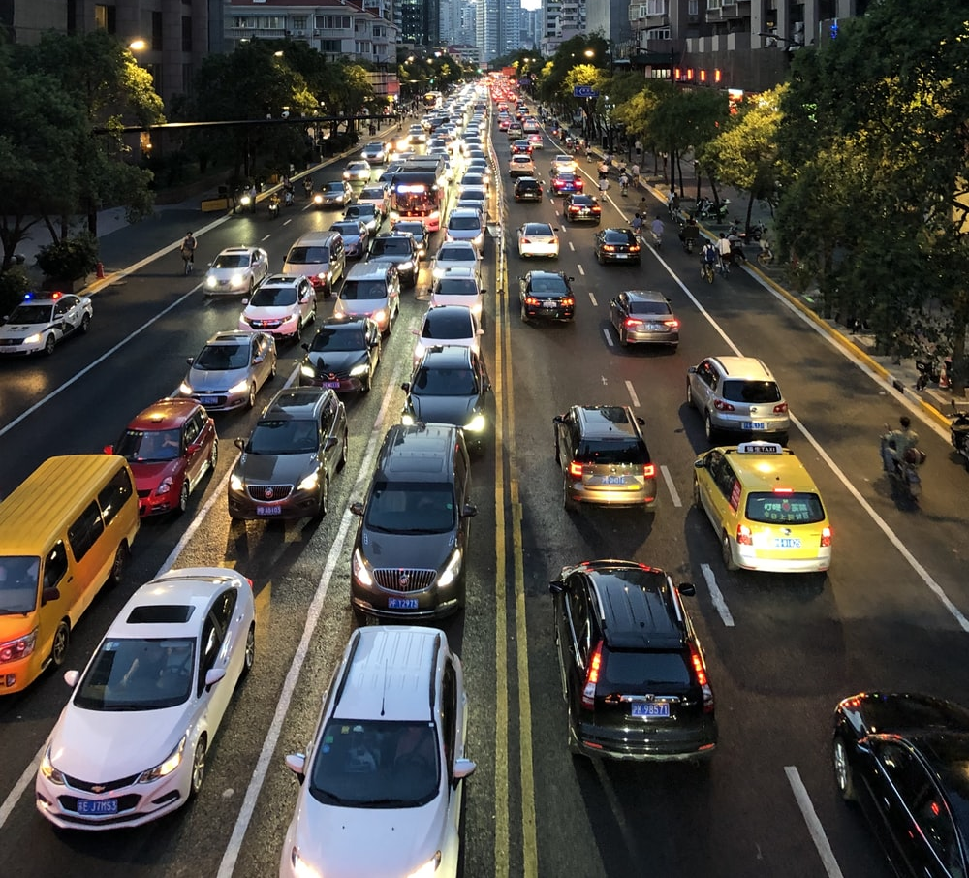
Data Structures | Queues
First one to enter the lane & First one to get out too!

Slide 37
Data Structures | Queues
ENQUEUE
DEQUEUE
5
4
3
2
1
REAR
FRONT
A Queue is a First-In-First-Out (FIFO) data structure

Slide 38
Data Structures | Queues using Arrays
JavaScript
let fruits = ['Apples', 'Strawberries', 'Grapes', 'Kiwi', 'Tomatoes']
Dequeue
let fruits = ['Strawberries', 'Grapes', 'Kiwi', 'Tomatoes']
Apples was the first element (ahead of the queue) in the Array and was removed first

Slide 39
Data Structures | Queues | Operations
Operation | What is does
enqueueing | Adding an item to the rear of queue
dequeuing | Removing the item at the front of the queue
peek | Viewing the element at the front of the queue
isFull | To check if the queue is full or not
isEmpty | To check if a queue is empty or not
initialize | Create a new queue

Slide 40
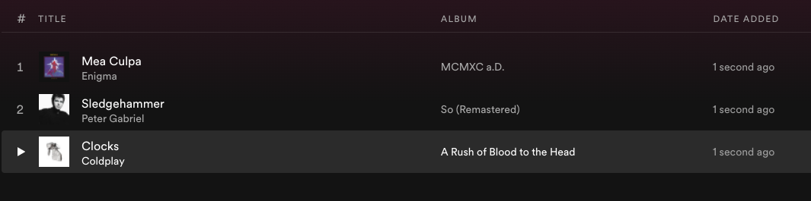
Data Structures | Queues | Use Cases
Playlists are a great use case of queues. Songs added first will play first

Slide 41
Choosing the Right Data Structure
Case Studies

Slide 42
Data Structures | Use Cases
Data Structure | Use Case | Rationale
Stack | Browser history tracking | A stack is ideal because the most recently visited pages are accessed first when navigating back, which follows the Last-In-First-Out (LIFO) principle.
Array | Storing student names in a classroom | Arrays are perfect for a fixed-size list of elements where elements are frequently accessed by index, such as looking up a student's name by their roll number.
Hash Map | Phone book | Hash maps provide efficient lookup, insertion, and deletion for key-value pairs like names and phone numbers.
Queue | Customer service hotline | A queue's First-In-First-Out (FIFO) model ensures customers are served in the order they called.
Stack | Undo functionality in an application | Stacks allow for operations to be stored and then undone in reverse order, aligning with the LIFO concept.
Array | Seating chart for a theater | An array can efficiently represent fixed seating with direct access to each seat's status (occupied or empty).
Hash Map | Caching user profiles | Hash maps enable quick retrieval of user profiles through unique keys, which is optimal for caching systems.
Queue | Print job management in a printer | Queues ensure print jobs are processed in the order they were received.
Stack | Parentheses balancing in code editors | Stacks help in ensuring the correct pairing and nesting of opening and closing parentheses by pushing and popping them off the stack.

Slide 43
Data Structures | Use Cases
Data Structure | Use Case | Rationale
Array | Game board in a digital board game | Arrays provide a simple structure for grid-based board games, allowing for two-dimensional layout and direct access to each cell.
Hash Map | Storing product prices in an inventory | Hash maps can quickly retrieve the price of a product using the product ID as a key, making it suitable for point-of-sale systems.
Queue | Processing tasks on a web server | A queue can handle requests in the order they arrive, ensuring fairness and efficiency in request processing.
Stack | Backtracking in maze-solving algorithms | Stacks can keep track of the path taken and facilitate stepping back to previous positions when backtracking is needed.
Array | Storing RGB values for a color palette | Arrays allow for the storage of a fixed set of color values that can be iterated over or accessed directly by index.
Hash Map | Associating usernames with access levels | Hash maps enable a quick look up to determine a user's access level based on their username, which is key in security systems.
Queue | Order processing in an e-commerce website | Using a queue ensures that orders are processed in the same sequence as they are placed, preserving fairness and chronological processing.
Stack | Tracking function calls in a program | Stacks are used to track active function calls and return addresses, naturally aligning with how functions are called and return in a nested manner (LIFO).

Slide 44
Data Structures | Use Cases
Data Structure | Use Case | Rationale
Array | Sensor data storage for a fixed time span | Arrays can store sensor readings taken at regular intervals, where the index corresponds to the time of reading, allowing for easy time-based access.
Hash Map | Language translation dictionary | Hash maps offer a fast retrieval of translations where the word in one language is the key and the translation is the value.
Queue | Serving requests in a drive-through | A queue ensures that customers are served in the order of arrival, which is critical for maintaining service efficiency and customer satisfaction in drive-throughs.

Slide 45
Pop Quiz
Q. Which data structure is commonly used for parentheses balancing in code editors?
Array
Stack
Hash Map
Queue

Slide 46
Pop Quiz
Q. Which data structure is commonly used for parentheses balancing in code editors?
Array
Stack
Hash Map
Queue

Slide 47
Understanding Pseudocode
Notes:
To the Instructor: Please go through the Trainer Guide - Learning Pseudocode.docx document before teaching this section. Also note that the syntax shown is just one of the several ways to express pseudocode and you're free to modify/innovate on top of it. However, we recommend sticking to this syntax to ensure everyone is on the same page.

Slide 48
Before You Write Code
1
2
3
4
5
6
7
8
9
10
Computer programs help you solve problems. When designing a solution to a problem, you begin by writing out the series of steps that are needed to achieve the result.

Slide 49
Before You Write Code - An Algorithm
1
2
3
4
An Algorithm
5
6
7
8
9
10
An algorithm is a sequence of ordered steps required to achieve a goal/solution

Slide 50
Computer Programming
Your Toolbox
Learning about the building blocks of a computer program

Slide 51
Computer Programming
Pseudocode
An artificial language that uses plain English language statements to express features & abilities like a real programming language

Slide 52
Pseudocode
SET L = array of 10 random numbers
FOR each number in L
IF number is even
PRINT number
ENDIF
ENDFOR
We'll use guidelines set by the California Polytechnic State University
Ref: https://users.csc.calpoly.edu/~jdalbey/SWE/pdl_std.html

Slide 53
Pseudocode - Why should you use it?
An artificial language, Pseudocode is not based on a specific programming language
Easy to learn
Allows you to express logic and functionality in a simplified manner
You can use it to express algorithms
Is used by both beginners and seasoned programmers
Is universally understood by everyone

Slide 54
Pseudocode
Input
User Interaction
Getting data to process
Reading Data from files
Getting data from an online service

Slide 55
Pseudocode | Input through User Interaction
GET the user's name
Ask the user to type in their name

Slide 56
Pseudocode | Input through User Interaction
GET the user's name as user
Ask the user to type in their name and store it in a variable named user

Slide 57
Pseudocode | Input through User Interaction
GET the first number as x
GET the second number as y
Ask the user to key in two numbers one after the other and store them in variables x and y respectively

Slide 58
Pseudocode | Reading Files
READ data from file: myStory.txt as story
Read the contents of the file myStory.txt and store it in a variable named story

Slide 59
Pseudocode | Input
GET the user's name as user
READ data from file: myStory.txt as story

Slide 60
Pseudocode
Output
Writing data to a file
Displaying the Results to the User

Slide 61
Pseudocode | Displaying Results on Screen
PRINT username
SHOW username
DISPLAY username
Will display the value stored in a variable named 'username'
Three ways to express an action that displays data on the screen

Slide 62
Pseudocode | Read & Display Contents of a File
READ data from file: myStory.txt as story
DISPLAY story
Read contents from a file named myStory.txt and display it on the screen

Slide 63
Pseudocode | Get user input and Display an Output
GET the user's name as userName
GET the user's profession as userProfession
DISPLAY "Hi, my name is userName and I work as a userProfession"
IN ACTION
INPUT
> "Joe Mason"
INPUT
> "Web Developer"
OUTPUT
> "Hi, my name is Joe Mason and I work as a Web Developer"
Ask the user for their name and profession and display the values in a sentence

Slide 64
Pseudocode | Get user input and Display an Output
GET the user's name as userName
GET the user's profession as userProfession
DISPLAY "Hi, my name is userName and I work as a userProfession"
IN ACTION
INPUT
> "Joe Mason"
INPUT
> "Web Developer"
OUTPUT
> "Hi, my name is Joe Mason and I work as a Web Developer"
INPUT
> "Sarah Shaw"
INPUT
> "Lead Designer"
OUTPUT
> "Hi, my name is Sarah Shaw and I work as a Lead Designer"
Ask the user for their name and profession and display the values in a sentence

Slide 65
Pseudocode | Get User Input & Write to a File
GET the user's name as userName
WRITE userName as file: user-data.txt
Ask the user for their name and write the value in a file named user-data.txt on disk

Slide 66
Pseudocode | Input & Output
INPUT
OUTPUT
PRINT variableName
SHOW variableName
DISPLAY variableName
WRITE content as file: filename
GET data as variableName
READ data from file: fileName

Slide 67
Pseudocode
Creating & Setting Variables

Slide 68
Pseudocode | Automatically Initializing Variables
These variables are created automatically, and values assigned
GET the user's name as userName
READ data from file: myStory.txt as story

Slide 69
Pseudocode | Creating Variables
SET x to 20
Create a variable named x and store the number 20 as its value

Slide 70
Pseudocode | Creating Variables
SET x to 20
Create a variable named x and store the number 20 as its value
SET L to a list of 10 random numbers
The variable L would have an array like [9, 2, 8, 7, 6, 10, 102.2, 3, 90, 34]

Slide 71
Pseudocode | Creating Variables
SET x to 20
Create a variable named x and store the number 20 as its value
SET L to a list of 10 random numbers
The variable L would have an array like [9, 2, 8, 7, 6, 10, 102.2, 3, 90, 34]
SET user to 'Michael J'
Create a variable named 'user' and store the String 'Michael J' as its value

Slide 72
Pseudocode | Exercise #1
Write a Pseudocode program that computes the total cost of an order given the cost of a single product, the discount applicable and the quantity purchased

Slide 73
Pseudocode | Exercise #1
SET discount to 10
GET the cost of the product as baseCost
GET the quantity purchased as quantity
SET savings as (discount / 100) x baseCost
SET totalCostOfOneUnit as baseCost - savings
SET totalPayable as totalCostOfOneUnit x quantity
DISPLAY "You need to pay totalPayable"
IN ACTION
> 250
> 10
> "You need to pay 2250"

Slide 74
Pseudocode | Exercise #2
Write a Pseudocode program that computes the volume of a box given its length, width and height

Slide 75
Pseudocode | Exercise #2
GET the length of the box as length
GET the width of the box as width
GET the height of the box as height
SET volume as length x width x height
DISPLAY "Volume of box is volume"
IN ACTION
> 20
> 10
> 30
> "Volume of box is 6000"

Slide 76
Summary
Broke ground on the critical role data structures play in organizing and managing data.
Dived into stacks, arrays, hash maps, and queues, revealing their unique properties and uses.
Presented case studies to illustrate the impact of choosing the appropriate data structure for different scenarios.
Gained clarity on pseudocode as a tool to express algorithms, bridging the gap between problem-solving and programming.

Slide 77



Slide 78
Thank You
Copyright © Upgrad., All rights reserved
Confidential Information, intended for approved distribution list of Upgrad

